Slide 1
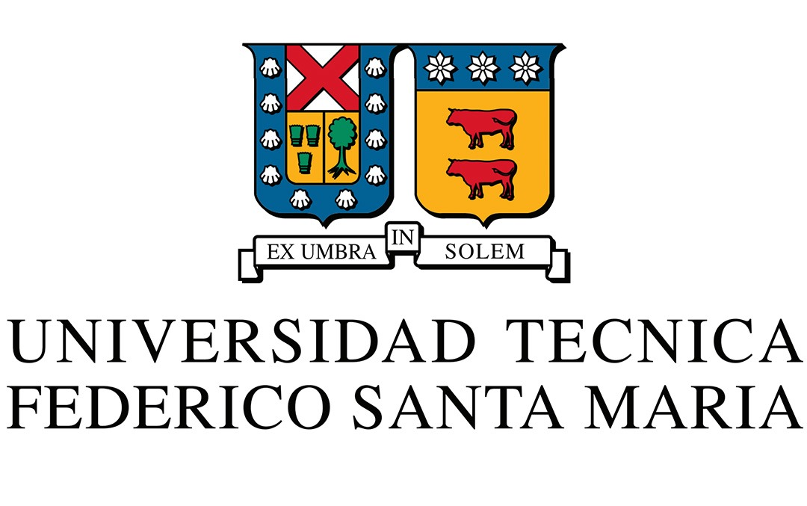



QuAntü – Theoretical Research Line
“Neutral-atom-based quantum computing in Chile”
Alonso Recabarren
Bachelor student in Physics
Departamento de Física, Campus San Joaquín, Santiago
Universidad Técnica Federico Santa María
Kick-off meeting QUANTÜ, Anillo Temático ATE250066

Slide 2
Main Objective and Methodology
Research Line: "Microscopic modeling and engineering of open quantum-driven evolution in neutral atom systems"
Main Objective
Experiment
Theory
Algorithms
Develop first-principles theoretical models and advanced quantum control strategies to enable high-fidelity quantum gates in neutral atom systems under realistic experimental conditions.
Methodology
Advanced quantum models for MOT.
Protocols for initialization, control and read-out of Rubidium atoms.
Quantum optimal control techniques for
single and two-qubits gates.

Slide 3
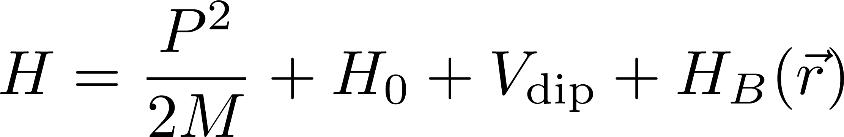
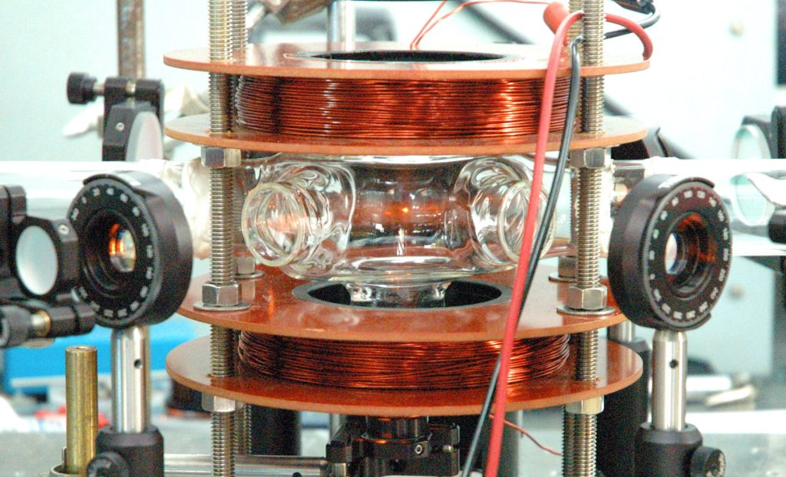
Project
Year 1 Milestone: “Open dynamics of neutral atoms"
Year 2 Milestone: “Theoretical modeling of one-qubit gates and quantum control optimization "
Courtesy of BCIT
Year 3Milestone: “Theoretical modeling of two-qubit gates and quantum control optimization”

Slide 4
Laser cooling

Slide 5
Saturated Absorption Spectroscopy

Slide 6
Open Quantum Systems

Slide 7
Rubidium gas

Slide 8
Microscopic models

Slide 9
Hyperfine structure for Rb87

Slide 10
Zeeman effect

Slide 11
Absorption spectrum Rubidium gas

Slide 12
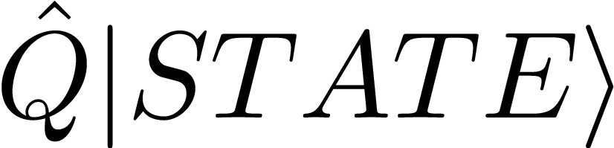
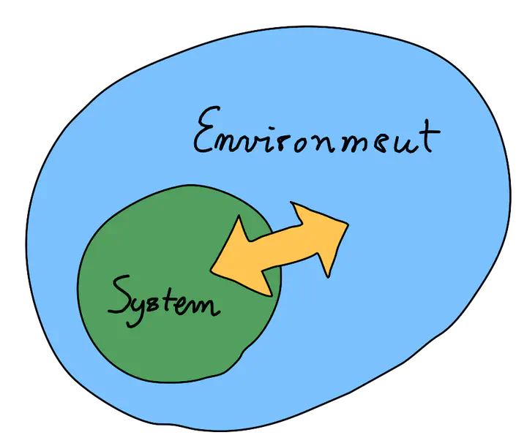
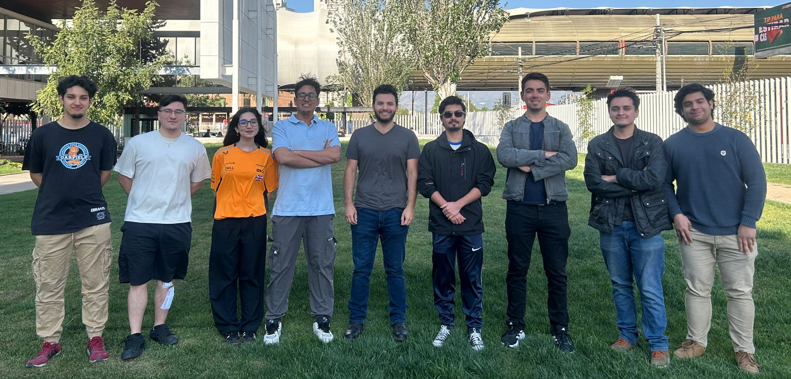
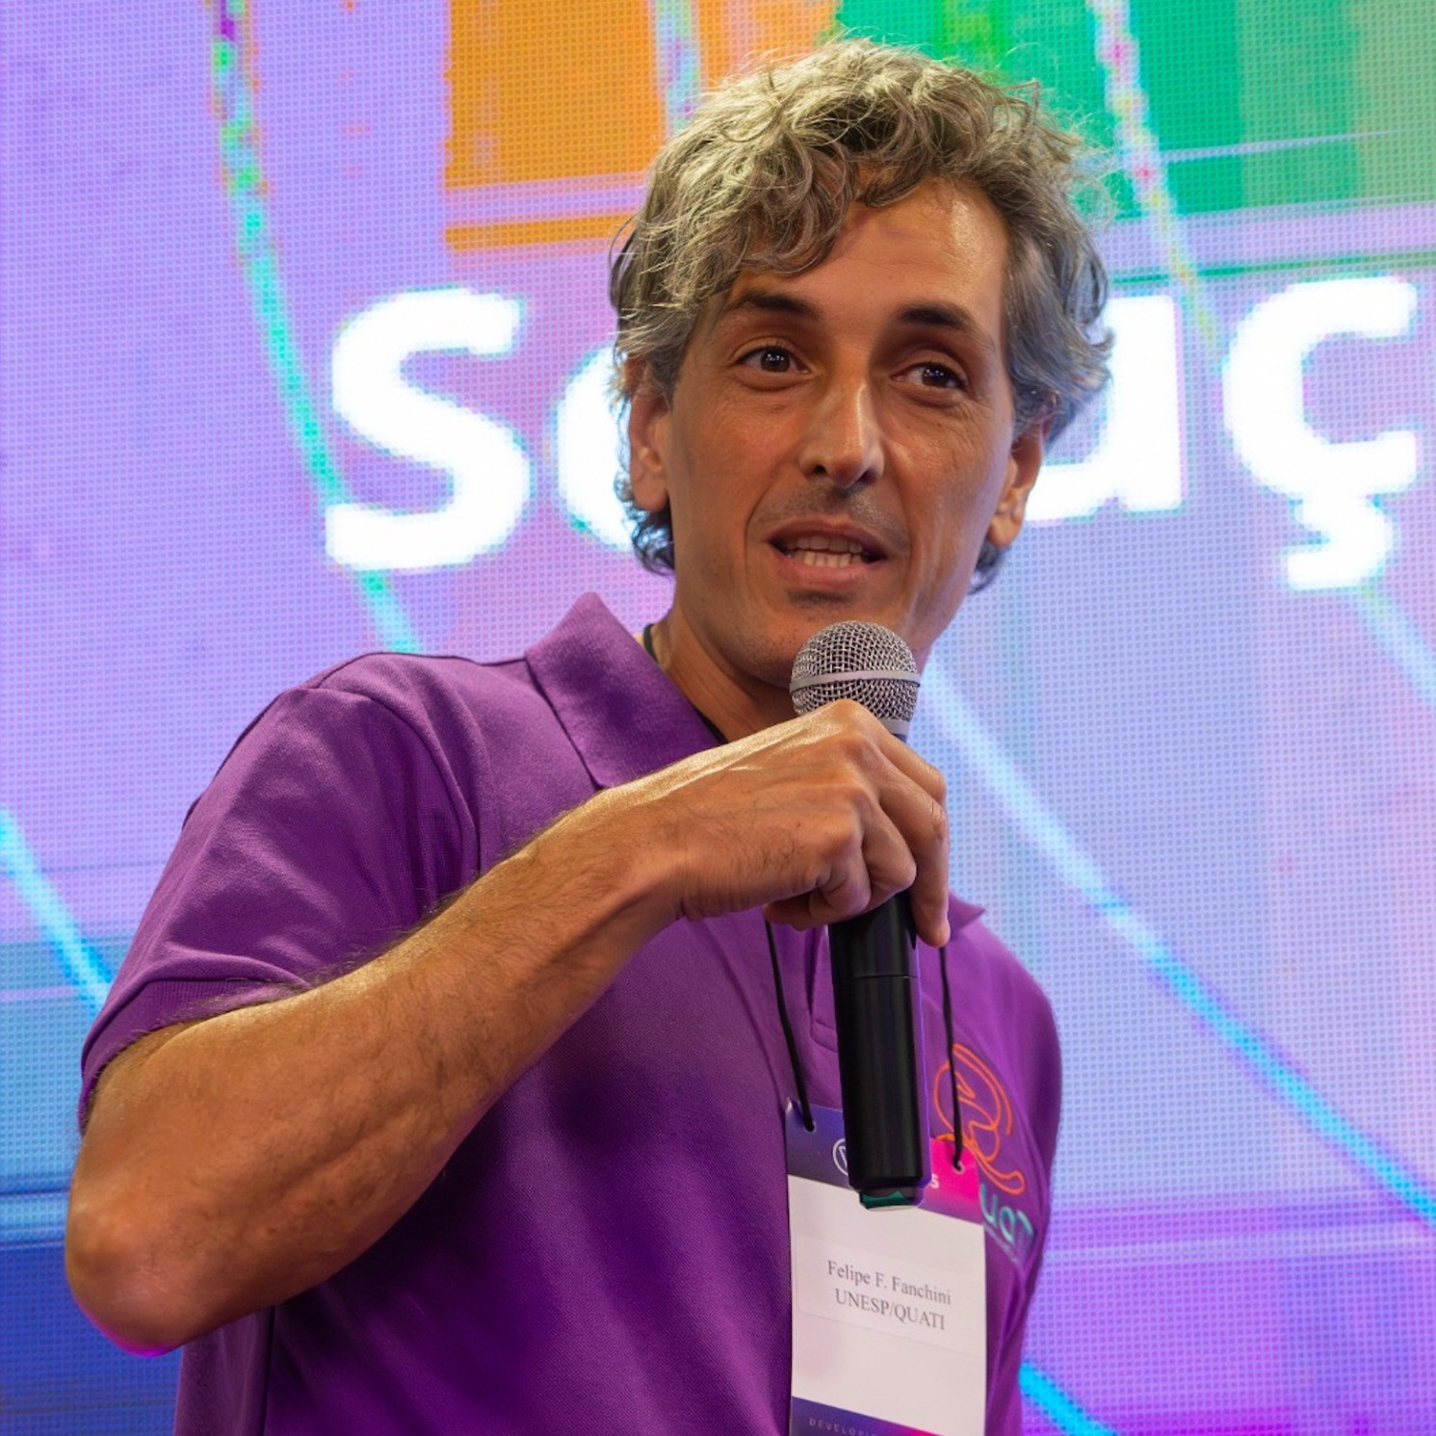
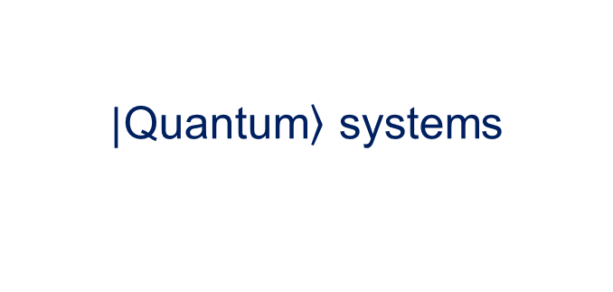

Quantum Systems, Theory And Technology
Open Quantum Systems
$\left.|\text{Quantum}\right\rangle$ systems
Color centers
Spin systems
Cavity QED
Atom-like
Algorithms
for Quantum
Quantum
Control
$$\hat{P}eople$$
Felipe Fanchini
UNESP
Internships: 3 UNESP
Physics & Astrophysics
Civil Engineer in Physics
Civil Telematics Engineering
Computer Science

Slide 13


